Slide 1
Archival and Retrieval of missing Items Using Image Matching (FindAm)
Task 4: System modelling and Design

Slide 2
Outline
Mercury is the closest planet to the Sun
01
Introduction
Context Diagram
Context mdel
02
Use Case
Sequence Diagram
Class Diagram
03
Interaction Model
Deployment Diagram
Structural Model
04

Slide 3
Context Diagram
Users
Image Database
02
Responsible for uploading images, submitting search queries, and retrieving images upon successful payment.
The database stores all images and meta data
External Factors (Entities)
01
03
Payment service
Image recognition service
Processes payments for image retrieval, ensuring that retrievals are authorized only after successful payment.
It analyses and recognizes content within uploaded images, returning descriptive data to the system.
04

Slide 4
Dataflow
Request Image Analysis
Request Return search result
Upload Image
Store Image
The user uploads an image to the system
FindAm stores the uploaded image in the database along with initial metadata.
FindAm sends the uploaded image to the recognition service for analysis.
The system returns the search results to the user.
Receive Recognition Data:
Index Image
Payment Request:
Payment Confirmation
The System indexes the image with the received
The system sends a payment request to the payment service when a search query is made
The payment service confirms the payment to the system.
returns analyzed data, including tags, descriptions, and features, to the system.

Slide 5
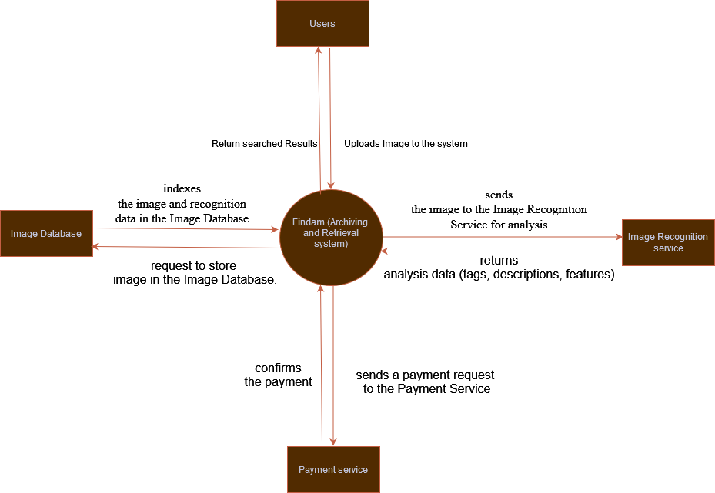
Context Diagram for FindAm

Slide 6
Use Case
Actors
Has two actors
User
Founder
Finder
System

Slide 7
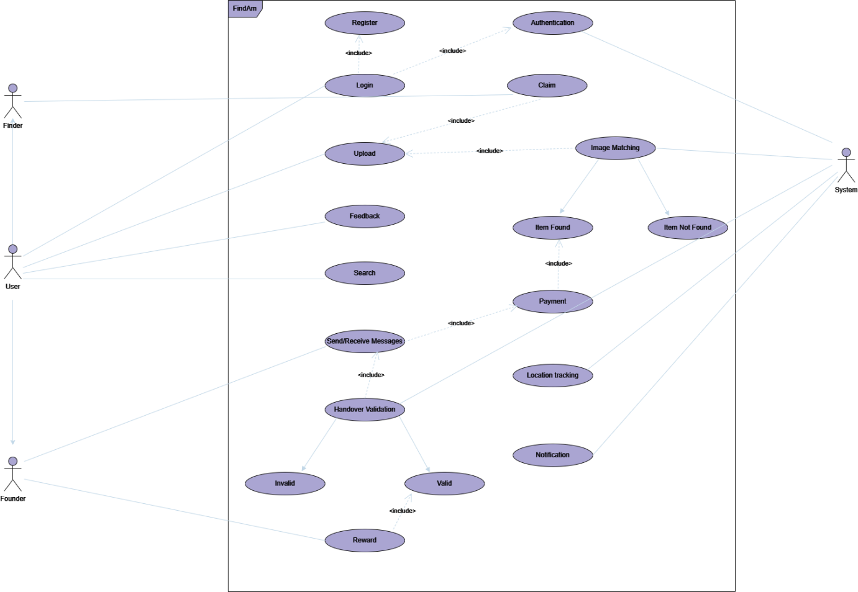

Slide 8
Sequence Diagram
Components
Responsible for uploading and retrieving images
User
User interface that allows users to interact with the system
Mobile App (UI)
Processes user provided image
Image Recognition module
Handles users authentication to ensure secure access of app
Authentication module

Slide 9
Sequence Diagram
Components
Processes requests and interacts with the database
Server
Stores meta data of file items
Database
Handles payment transaction upon successful retrieval
Payment Gateway

Slide 10
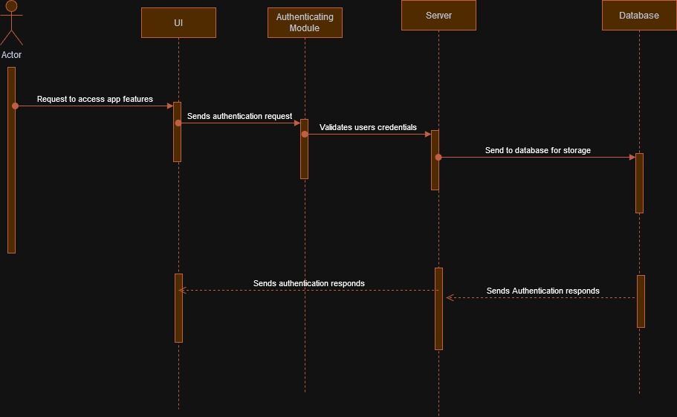
Authentication sequence

Slide 11
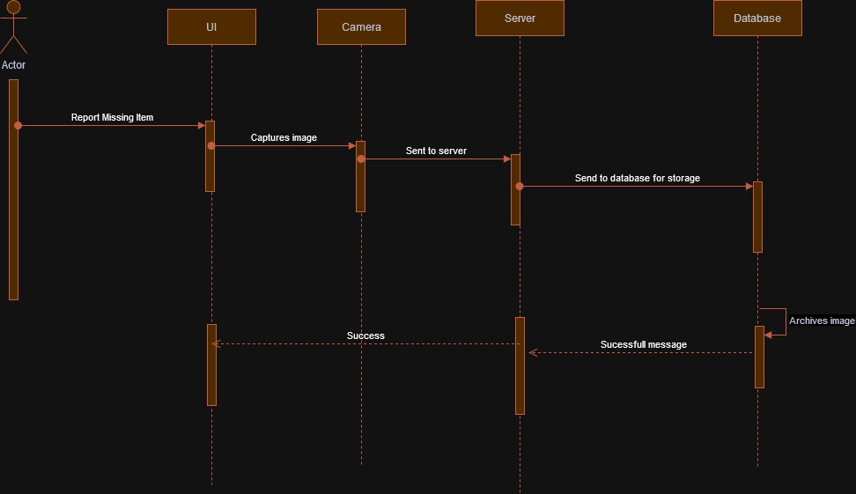
Archival sequence

Slide 12
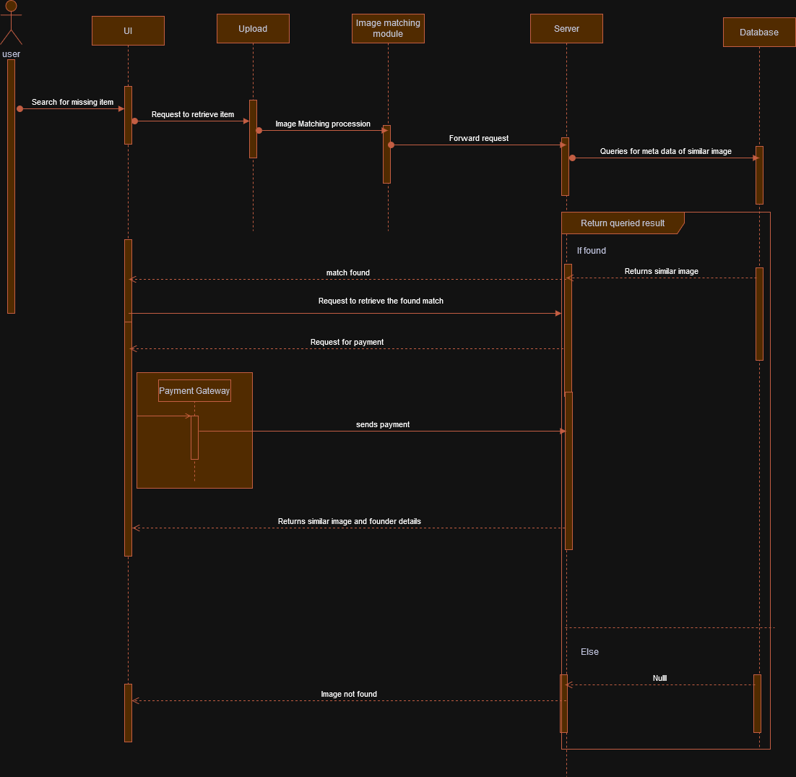
Retrieving Sequence

Slide 13
Class Diagram
Users
01
Items
02
03
Reward
04
Notification

Slide 14
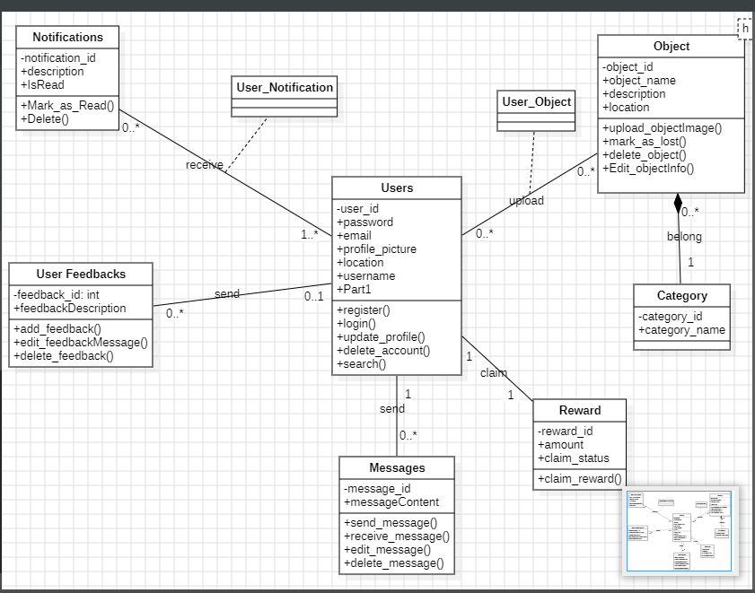
Class Diagram

Slide 15
Deployment Diagram
Mobile app
Authentication module
Image matching module
User Device (Mobile Phone)
Application server
Image matching Service
Authentication service
Web Server
Nodes and components
Database Management System
Image metadata
Database Server
Image storage service
Cloud Storage

Slide 16
